Slide 1
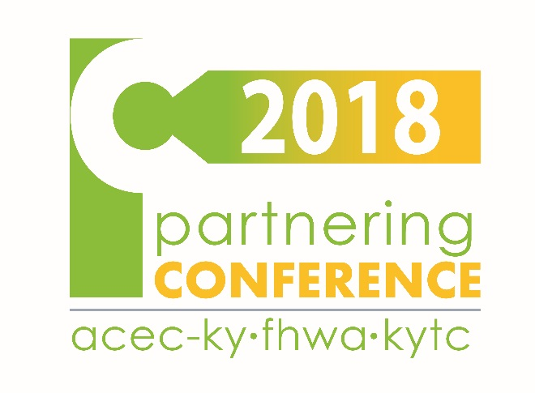
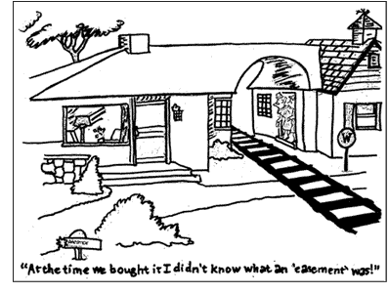
Utility Accommodation in ROW & Utility Easements
Dean Loy, Director
Division of Right Of Way and Utilities
Jennifer McCleve, Branch Manager
Utilities and Rail Branch

Slide 2
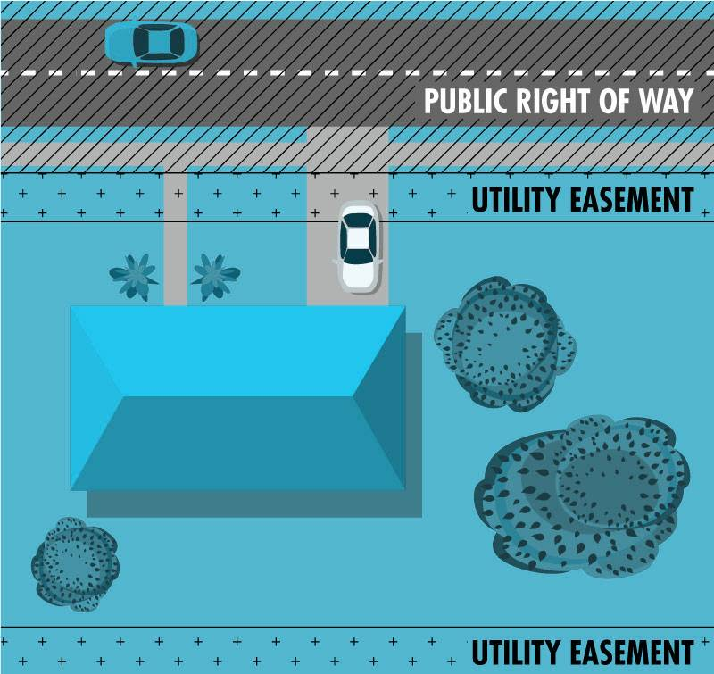
ROW
Easements in ROW
Replacement Utility Easements
Joint Utility Easements

Slide 3
What is a ROW?
A right-of-way (ROW) allows others to travel through a property.
It provides access to anyone who may need to travel through the property.

Slide 4
What is a ROW?
KYTC Right of way in its truest sense is the land that a highway occupies including:
land owned by the operating agency
land that the operating agency has a right to use for roadway purposes
The rights required to support a roadway must include sufficient interest to provide for both the construction and continued maintenance of the facility.

Slide 5
What is an EASEMENT?
An easement is the right to use the real property of another for a specific purpose; such as, drainage, utility facilities, construction, or maintenance.
An easement is a real property interest, but legal title to the underlying land is retained by the original owner.

Slide 6
What is an EASEMENT?
Easements are created by one of three ways:
Easement by Express
Easement by Implication
Easement by Prescription
Easements fall into two categories:
affirmative
negative

Slide 7
Laws and Regulations
KRS 177.035
KRS 179.265
23 CFR 645.111 Subp A

Slide 8
KRS 177.035
Cost of relocation of publicly or privately owned utility equipment and appliances to be borne by the Cabinet
Any municipality/publicly owned utility shall be relocated and reimbursed by the Department for projects.
Needs:
Relocation plan
Construction schedule
Agreement
The utility can be reimbursed for up to 12 months after the work.

Slide 9
KRS 177.035
Utility Easements
 |  |  | Reimbursable?
Utility Type | Ex Facilities on: | Relocating To: | Now? | Future?
Private | ROW | ROW | NO | NO
 | ROW | Easement | NO | YES
 | Other than ROW | ROW | YES | NO
 | Other than ROW | Easement | YES | YES
Public | ROW | ROW | YES | YES
 | ROW | Easement | YES | YES
 | Other than ROW | ROW | YES | YES
 | Other than ROW | Easement | YES | YES

Slide 10
KRS 179.265
Cost of relocation of privately owned utility equipment and appliances to be borne by the Cabinet
Such facilities can be reimbursed only if they are outside of public right of way and must be relocated.

Slide 11
KRS 179.265
Utility Easements
 |  |  | Reimbursable?
Utility Type | Ex Facilities on: | Relocating To: | Now? | Future?
Private | ROW | ROW | NO | NO
 | ROW | Easement | NO | YES
 | Other than ROW | ROW | YES | NO
 | Other than ROW | Easement | YES | YES
Public | ROW | ROW | YES | YES
 | ROW | Easement | YES | YES
 | Other than ROW | ROW | YES | YES
 | Other than ROW | Easement | YES | YES

Slide 12
How does KRS 179.265 make sense?
A private for profit company pays to occupy space on other than public row.
If they had sough permit to go in ROW, that would be at no cost.
They have a reasonable expectation of not being impacted by a road project.
The cost to relocate and make the utility whole should be borne by the project.

Slide 13
23 CFR 645.111 Subp A
(a) Federal participation may be approved for the cost of replacement right of way provided:
(1) The utility has the right of occupancy in its existing location…fee, an easement, or other real property interest.
(2) There will be no charge to the project for that portion of the utility’s existing right of way being transferred to the TD for highway purposes
(b) The utility shall determine and make a written valuation of the replacement right of way that it acquires in order to justify amounts paid for such right of way
(c) Acquisition of replacement right of way by the TD on behalf of a utility or acquisition of non-operating real property from a utility shall be in accordance with Uniform Relocation Assistance and real Property Acquisition Policies Act
(d) When the utility has the right of occupancy in its existing location because it holds the fee, an easement, or another real property interest and it is not necessary by reason of the highway construction to adjust or replace the facilities located thereon, the taking of and damage to the utility’s real property, including the disposal or removal of such facilities may be considered a right of way transaction

Slide 14
23 CFR 645.111 Subp A
TRANSLATED
Federal funds may be used for replacement easement for utilities
Either a state or a utility may purchase replacement easement for utility relocations:
If a state acquires the Uniform Act applies.
If the utility acquires the Uniform Act does not apply.
Federal funds may be used for replacement right of way for utilities where the existing utility facilities are located on public right of way with no property interests.

Slide 15
ROW
AASHTO Guidance
When a State or locality routinely dedicates or permits a portion of the road and street ROW for use by utilities in accordance with established standard criteria pursuant to State law, ordinance, or administrative practice, such right-of-way may be considered eligible for Federal-aid reimbursement as an integral part of the project right-of-way.

Slide 16
ROW
23 CFR 1.23
There must be adequate space available to locate the utility facilities in a manner that does not interfere with the safe and efficient operations of the highway.

Slide 17
ROW
David Whitworth, Federal Highway Administration - Kentucky Division
Since the KYTC routinely permits a portion of the road (whenever possible) for use by utilities in accordance with established criteria pursuant to law, such right of way may be considered eligible for Federal-aid reimbursement as an integral part of the project right-of-way.

Slide 18
ROW
Conclusion
The ROW boundaries can and should consider existing permitted utilities when:
It is in the interest of the project economy, or
If it is necessary to meet the requirements of the highway project.
Note: The project team must document the decision (Why it is in the interest of the project economy).

Slide 19
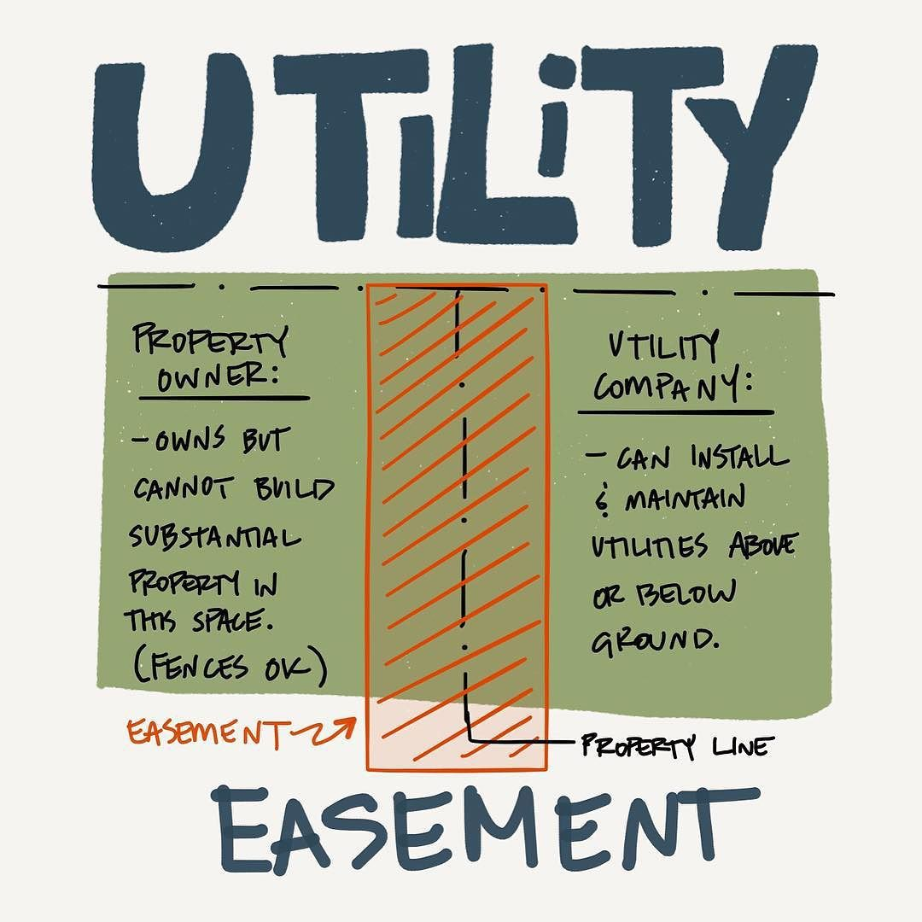
Utility Easements
in ROW

Slide 20
Utility Easements in ROW
Texas Gas requested exclusive easement rights in public right of way
Requested placement in road right of way with a 30 foot wide exclusivity.
Exclusivity would violate the provisions of KRS 416.140 which provides that “any” listed utility may install facilities on right of way. Exclusivity would contravene this statute…
OLS memorandum response…

Slide 21
Utility Easements in ROW
MEMORANDUM
TO: Jennifer McCleve
FROM: Will Fogle, Attorney Office of Legal Services
DATE: November 1, 2017
SUBJECT: Utility Easement Rights
You have asked for a legal opinion on a request of a utility company to be granted exclusive utility easement rights on public right of way. As an initial matter, this concept is not advisable from a practical matter since it would limit and restrict the future use of the affected property. Moreover, in my opinion, such a grant would be inconsistent with provisions of KRS 416.140, which provides that “…any person authorized under the laws of this state to conduct the business of supplying water, electricity, [etc]…may construct and maintain transmission or distribution lines…” KRS 416.140(1). Thus, the grant of an exclusive utility easement to one utility at the exclusion of all others would be in contraindication of this statute. Thus, I would strongly advise that this request be denied.

Slide 22
Easements in ROW
Conclusion
While KYTC can dedicate easement in public ROW, KYTC should not grant an exclusive utility easement in public ROW to one utility at the exclusion of others

Slide 23
Replacement
Utility Easements

Slide 24
Utility Easements
Kentucky Statute
Public utility companies (municipals, non-profits) are reimbursable regardless of property right.
Private for profit utilities are reimbursable when they occupy other than public right of way.

Slide 25
Replacement
Utility Easements
KENTUCKY
Utility Easements
 |  |  | Reimbursable?
Utility Type | Ex Facilities on: | Relocating To: | Now? | Future?
Private | ROW | ROW | NO | NO
 | ROW | Easement | NO | YES
 | Other than ROW | ROW | YES | NO
 | Other than ROW | Easement | YES | YES
Public | ROW | ROW | YES | YES
 | ROW | Easement | YES | YES
 | Other than ROW | ROW | YES | YES
 | Other than ROW | Easement | YES | YES

Slide 26
Replacement
Utility Easements
KENTUCKY
Are we acquiring and transferring them to the utility?
We do sometimes acquire easement for a utility but we are not transferring them to our knowledge. These transfers would need to go through the Division of Right of Way and Utilities and be signed by the Governor.
If not, should we be? Yes
Is this a betterment if the utility occupied no easement prior to relocation?
Defer to OLS and other DOT assessments but it appears to be a betterment.
If so, can Federal funds be used to acquire it? Not if there is betterment

Slide 27
Replacement
Utility Easements
KENTUCKY
Utility Easements
 |  |  | Reimbursable?
Utility Type | Ex Facilities on: | Relocating To: | Now? | Future?
Private | ROW | ROW | NO | NO
 | ROW | Easement | NO | YES*
 | Other than ROW | ROW | YES | NO
 | Other than ROW | Easement | YES | YES
Public | ROW | ROW | YES | YES
 | ROW | Easement | YES | YES
 | Other than ROW | ROW | YES | YES
 | Other than ROW | Easement | YES | YES

Slide 28
Replacement
Utility Easements
What options do we have to acquire utility easements and under what circumstances we can use one means versus another.
Surveyed 9 states to determine:
Use of utility specific easements
Use of general (joint use) easements

Slide 29
Replacement
Utility Easements
QUESTIONS ASKED
Does your DOT purchase utility specific easements on behalf of utility companies?
Does your DOT retain the easement and permit access to it or does the easement transfer to the company occupying it?
Does your DOT acquire this easement to replace existing easement only?
Would your DOT be able to acquire a utility specific easement if the company had no easement (had no property right) prior to relocation?
Is this considered a betterment if the utility occupied no easement (had no property right) prior to relocation?

Slide 30
Replacement
Utility Easements Survey
State | Does your DOT purchase utility specific easements on behalf of utility companies? |  | Does your DOT retain the easement and permit access to it as opposed to easement transferring to the company occupying it? |  | Does your DOT acquire this easement to replace existing easement only |  | Would your DOT be able to acquire a utility specific easement if the company had no easement (had no property right) prior to relocation? |  | Is this considered a betterment if the utility occupied no easement (had no property right) prior to relocation? It’s not considered a betterment.
DOT | Yes | No | Yes | No | Yes | No | Yes | No | Yes | No
Pennsylvania | Yes |  |  | No | Yes |  |  | No | Yes
Oregon | Yes Rarely |  |  | No | Yes |  |  | No | Yes
Virginia | Yes |  | Yes |  | Yes |  |  | No | Yes
Florida | Yes |  |  | No | Yes |  |  | No
West Virginia |  | No |  | No | Yes generally |  |  | No |  | No
Tennessee |  | No |  | N/A |  | N/A |  | N/A |  | N/A
Delaware |  | No |  | N/A |  | No |  | No |  | N/A
Alabama |  | No |  | No |  | No |  | No | Yes
Utah | Yes |  |  | No |  | No | Yes |  | Yes
Maryland | Yes occasionally |  |  | No |  | Yes |  | Not unless there was a hwy need & esmt would remain with the state |  | No

Slide 31
Replacement
Utility Easements
VIRGINIA MATT REYNOLDS
Does your DOT purchase utility specific easements on behalf of utility companies? Yes only as a replacement of an existing easement
Does your DOT retain the easement and permit access to it or does the easement transfer to the company occupying it? VDOT retains. *Pursuant to an explicit state law.
Does your DOT acquire this easement to replace existing easement only? Yes
Would your DOT be able to acquire a utility specific easement if the company had no easement (had no property right) prior to relocation? Not as a policy.
Is this considered a betterment if the utility occupied no easement (had no property right) prior to relocation? It would be if done

Slide 32
Replacement
Utility Easements
UTAH ALANA SPENDLOVE
We have regulations (Utah Admin Rule R930-8-7. Replacement of Property Rights) that gives us the authority to purchase replacement easements on behalf of utility owners.

Slide 33
Replacement Easements
Conclusion
Can be acquired only to replace an existing easement.
Must be specific to a utility company.
KYTC must transfer the easement to the utility if KYTC acquires it.

Slide 34
Joint Use
Utility Easements

Slide 35
Joint Use Utility Easements
Kentucky Statute
Public utility companies (municipals, non-profits) are reimbursable regardless of property right.
Private for profit utilities are reimbursable when they occupy other than public right of way.

Slide 36
Joint Use
Utility Easements
KENTUCKY
Utility Easements
 |  |  | Reimbursable?
Utility Type | Ex Facilities on: | Relocating To: | Now? | Future?
Private | ROW | ROW | NO | NO
 | ROW | Easement | NO | YES
 | Other than ROW | ROW | YES | NO
 | Other than ROW | Easement | YES | YES
Public | ROW | ROW | YES | YES
 | ROW | Easement | YES | YES
 | Other than ROW | ROW | YES | YES
 | Other than ROW | Easement | YES | YES

Slide 37
Joint Use
Utility Easements
KENTUCKY
General Utility Easements
Does KYTC have authority to regulate (permit) access to them? (Written authority?)
No we do not.
We should limit access with the easement description
Transfer to the utility owner
Does KYTC wish to own and permit access to them?
No we have no interest in retaining / maintaining these easements.
Is this a betterment if the utility occupied no easement prior to relocation?
Defer to OLS and other DOT assessments but it appears to be a betterment.
If so, can Federal funds be used to acquire it?
Not if there is betterment

Slide 38
Joint Utility Easements
QUESTIONS ASKED
Does your DOT purchase joint use easements?
Does your DOT regulate (permit) access to them? (If so, is it written authority?)
Does your DOT retain the easement and permit access to it or does the easement transfer to one of the companies occupying it?
Does your DOT permit a utility to occupy it when they had no easement (had no property right) prior to relocation?
If so, how do you track whom is reimbursable and whom is not if impacted in the future?
Is this a betterment if the utility occupied no easement (had no property right) prior to relocation?

Slide 39
Joint Utility Easements
State | Does your DOT purchase joint use easements? |  | Does your DOT regulate (permit) access to them? (If so, is it written authority?) |  | Does your DOT retain the easement and permit access to it as opposed to easement transferring to one of the companies occupying it? |  | Does your DOT permit a utility to occupy it when they had no easement (had no property right) prior to relocation? |  | If so, how do you track whom is reimbursable and whom is not if impacted in the future? |  | Is this a betterment if the utility occupied no easement (had no property right) prior to relocation?
DOT | Yes | No | Yes | No | Yes | No | Yes | No | Text | N/A | Yes | No
Pennsylvania |  | No |  | No |  | No |  | No |  | N/A |  | N/A
Oregon |  | No |  | No |  | No |  | No |  | N/A |  | N/A
Virginia | Yes |  | Yes |  | Yes |  | Yes |  | VDOT requires a copy of recorded easments to demonstrate reimbursable. Joint Use easement use is not reimbursable unless it overlaps an easement in the company's name. |  |  | No
Florida |  | No |  | No |  | No |  | No |  | N/A |  | N/A
West Virginia | New legislation allows |  | Yes uts lease access |  | Yes |  | Yes |  | DOT considering a tracking database to help |  |  | No
Tennessee |  | No |  | No |  | N/A |  | N/A |  | N/A |  | N/A
Delaware | Yes |  | Yes regulate not permit |  | Yes |  | Yes |  | The utility provides evidence of property right. |  |  | No
Alabama |  | No |  | N/A |  | N/A |  | N/A |  | N/A |  | N/A
Utah |  | No |  | N/A |  | N/A |  | N/A |  | N/A |  | N/A
Maryland | Yes occasionlly |  | Yes |  | Yes |  | Yes |  | Prior rights is tracked through Office of Real Estate |  |  | No

Slide 40
Joint Utility Easements
VIRGINIA MATT REYNOLDS
We do purchase "Joint Use VDOT Utility Easements" to permit utilities into that do not have an existing land right (easement) but have to be relocated for the project outside of existing/proposed right of way to be clear for construction activities. These also can overlap company named easements we purchase only when replacing and existing recorded easements.
This has been going well and have not experienced any significant issues and the practice has been accepted by the utility owners.
General Utility Easements (acquisition of a utility easement that can be used by multiple companies, perhaps called ‘Joint Use’?)
Does your DOT purchase joint use easements? Yes
Does your DOT regulate (permit) access to them? (If so, is it written authority?) Yes through our Land Use Permitting System
Does your DOT retain the easement and permit access to it or does the easement transfer to one of the companies occupying it? VDOT retains unless it is overlapping with an easement in a company's name that is being replaced for the project/parcel
Does your DOT permit a utility to occupy it when they had no easement (had no property right) prior to relocation? Yes
If so, how do you track whom is reimbursable and whom is not if impacted in the future? If the easement is in VDOT's name they do not have a future reimbursable right unless they overlap with an easement in the utilities name or acquire the right later from the landowner. VDOT requires a copy of a recorded easement to demonstrate a reimbursable right.
Is this a betterment if the utility occupied no easement (had no property right) prior to relocation? No, since the easement land right is retained by VDOT

Slide 41
Joint Utility Easements
WEST VIRGINIA ANTHONY CAROVILLANO
General Utility Easements (acquisition of a utility easement that can be used by multiple companies, perhaps called ‘Joint Use’?)
Does your DOT purchase joint use easements? Recent Legislation has given the DOT authority to purchase Utility Corridors for joint use. I’m currently working on the implementation of this legislation so I don’t have any results to share.
Does your DOT regulate (permit) access to them? (If so, is it written authority?) If we purchase/establish a Utility Corridor then all utilities, current and future, will be required to locate in the corridor. We will charge the companies a lease to occupy the corridor but any future moves will be the DOT’s financial responsibility
Does your DOT retain the easement and permit access to it or does the easement transfer to one of the companies occupying it? We will retain ownership of the corridor
Does your DOT permit a utility to occupy it when they had no easement (had no property right) prior to relocation? Yes
If so, how do you track whom is reimbursable and whom is not if impacted in the future? We haven’t thought that far out but I’m looking at building an interactive map/database to help us track our leases and permits
Is this a betterment if the utility occupied no easement (had no property right) prior to relocation? No, it hasn’t been in the past
Utility Specific Easements (acquisition of a utility easement that can be used for a specific company relocation)
Does your DOT purchase utility specific easements on behalf of utility companies? No but we will reimburse a public utility (Public Service District & Municipalities) for acquisition costs
Does your DOT retain the easement and permit access to it or does the easement transfer to the company occupying it? The easement will stay with the company
Does your DOT acquire this easement to replace existing easement only? Generally but there have been times in which a public utility has elected to move out of our R/W into an acquired easement
Would your DOT be able to acquire a utility specific easement if the company had no easement (had no property right) prior to relocation? We would reimburse a public utility but we would not acquire for them
Is this considered a betterment if the utility occupied no easement (had no property right) prior to relocation? No, it hasn’t been in the past

Slide 42
Joint Utility Easements
Conclusion
Most states do not use / acquire joint use easements.
Those that do have law, policy and a regulation and permit process.
Since KYTC has none of these, specific conditions are needed:

Slide 43
Conditions for
Joint Use Easements:
Use for specific groups of utility companies
Those companies have replacement easement rights
The easement should be described for those facility types.
The easement should be conveyed to owner utility(ies).

Slide 44
Questions
See handout guide that covers:
ROW
Easements in ROW
Replacement Utility Easements
Joint Utility Easements

